Slide 1
SOCIAL ADVOCACY AND COMMUNITY SERVICE
FINAL PROJECT-PRESENTATION
Muhammad Hassan Yousfani 20181-24866

Slide 2
This presentation will cover:
Project idea
Proposed business feasibility
Criteria for selecting individual
Selected individual
Why he had to shutdown his previous business
His financial responsibilities
House hold characteristics
Funds required
Donation collection plan
Each member contribution
Financial detail of the business
Store location
Receipt's of the products
Mobile accessories picture
Final look of the shop

Slide 3
Project Idea:
Our aim was to find a needy person and construct a business for him and hand him over the business. We firstly opted for welding business but since one of our group member dropped the course, we were unable to finance such a business. We have now opted to open a mobile accessories shop in Gulshan-e- Iqbal. Sine we feel mobile accessories shop is now a trending business while also being economical since everyone own a mobile phone.
Covid-19 has severely impacted life of everyone in a negative way. We made a aim to find such an individual who is passionate about the work he does and beliefs in hard working so any business we set up could progress in the near future. Giving that family a stable income where he can fulfill his family needs which now seem to be more of luxury.

Slide 4
Proposed business feasibility
We will open our beneficiary a mobile accessories shop here in Karachi at Gulshan market. Since he has prior experience and customers, we are hoping his business will take of in 2-3 months. We will pay shop rent up to 4 months after that he would have to bear his own expense.
To make sure that his business in running he would have direct contact with us, to monitor the success of the business we will pay surprise visit and look at his finances furthermore after 4 months he has to pay as 3% of his profit so in that way we will be able to keep check and balance.

Slide 5
Criteria of selecting individual
Hard working
Know how of the business
Honest
Knows how to capture the market share
Prior experience
Can grow the business
Lost his job due to Covid-19
Looking for investment to start a business

Slide 6
Selected individual
Name: Muhammad Kashif
Previous business: Welding workshop
Location: Dalmia market, Karachi
Now: Drives a rented rickshaw
Skills: Mobile accessories – learn and sell back in 2016
Why he had to close down his previous business:
Covid-19 and then lockdown
Due to health issue had to move to Punjab
In debt due to medical reason

Slide 7
Financial Responsibilities
House rent: 10,000
Utility average bill: 3,000
Monthly average food budget: 10,000
Sends money anywhere or not: N/A
Any other responsibility: daily 600
Household Characteristics:
Family members: 4 (parents and kids)
Children: 2 (toddlers) 1 year and 4 year old
Wife job: house hold maid

Slide 8
FUNDS REQUIRED
Estimated budget 100,0000 PKR
Expected budget 80,000 - 90,000 PKR
Product list:
USB
Handsfrees
Charger
Dock/ Shu
Batteries
Car Charger
Glass protector
Mobile covers
Glass Screening
OTG
Card reader
Speakers
Bluetooth
Neck band
Cables
Powerbank
Shop in Gulshan: Rent 9,000 per month
Maintenance cost : 1,300 per month
Total: 10,300 per month
Estimated time for business to take off: 2-3 months

Slide 9

Donation collection plan
We targeted for Zakat, Sadqa and Charity for collection of funds. We had put up post on Facebook, Instagram and personally messaged people on watsapp and we also connected with NGO’s who could help us collect donation. Sadly, due to covid-19 and lockdown we received very few donations from these platform.
Then we targeted our family and friends who we knew had the funds to donate. We successfully collected;
Zainab: 73k
Hassan: 35k
Simran: 10k
Total: 118k

Slide 10
Each Member Contribution
Zainab:
Found the individual
Did first interview
Monitor the whole project
Helped in collecting 73K donations
Hassan:
Daily direct connection with the individual
Shop hunting
Purchasing of products
Financial check and balance
Setting the whole shop
Training the individual
Helped in collecting 35K donation
Simran:
Helped in collecting 10k donation

Slide 11
Financial details of the business
Product details
Category | Pieces | Remarks | Total Cost
USB | 11 | Packet | 8075
Handsfrees | 208 | Open & Packet | 23930
Chargers | 44 | Packet | 6695
Dock/ Shu | 18 | Open | 4380
Batteries | 22 | Pack | 10350
Car Charger | 2 | Open | 220
Glass | 375 |  | 8075
Covers | 23 |  | 1860
Glass Screening | 1 | Bottle | 130
OTG | 5 | Open | 75
OTG | 1 | Pack of 20 | 200
Card reader | 1 | Pack of 20 | 180
Speakers | 5 | Pack | 2590
Bluetooth | 11 | Pack | 5170
Neck band | 3 | Pack | 1820
Cables | 107 | Open and Packet | 8725
Powerbank | 4 | Packs | 4250
 |  |  | 86725

Slide 12
Shop details
Buidget received |  | 118,000
Rent |  | 9000
Agent |  | 9000
Expenses:
 | Fan | 3900
 | 2 Chairs | 2700
 | 2 Savor Bulb | 350
 | Carpenter | 550
 | Carpet And dastar | 520
 | Racks | 2500
 |  | 28,520
Expense excluded
 | Maintainance | 1300
 | Inner Glasss | 2800
 | Statinoary | 500
 |  | 4600

Slide 13
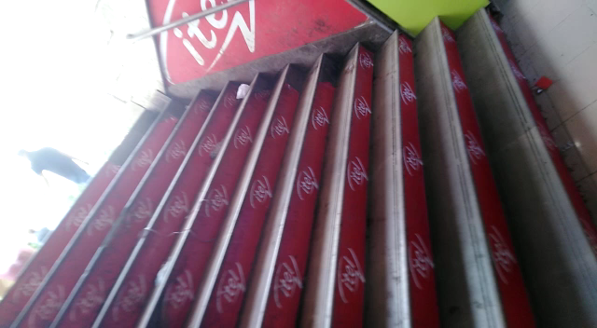
STORE LOCATION

Slide 14
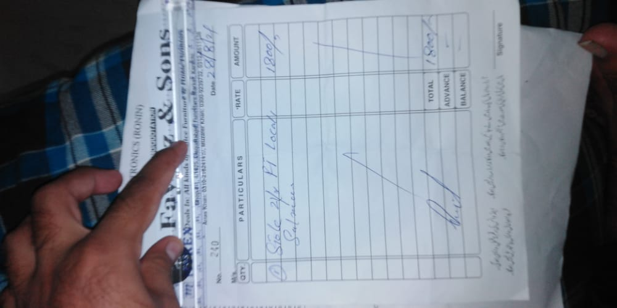
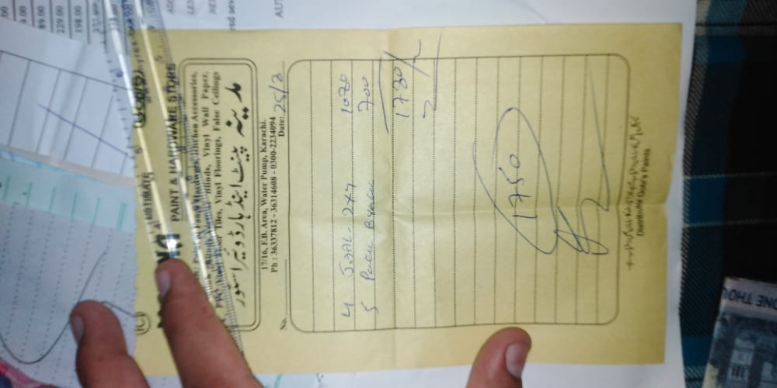
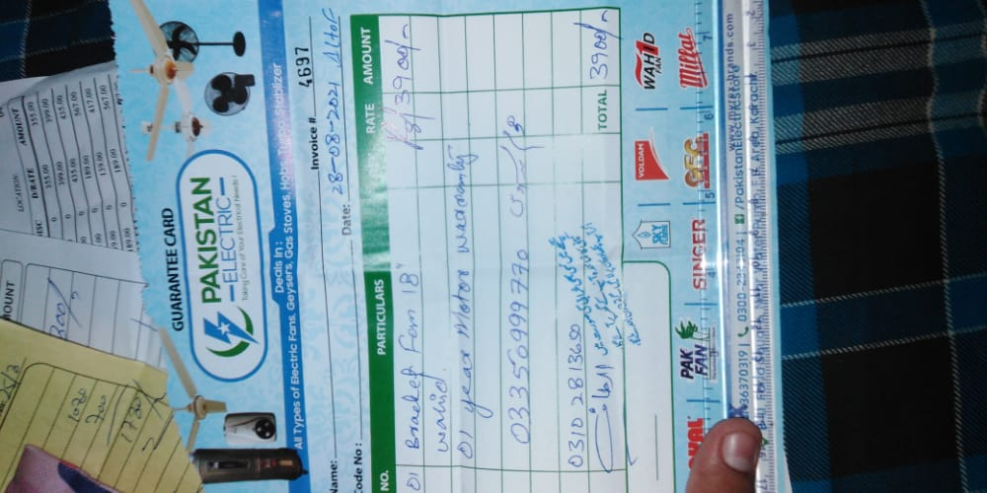
RECEIPTS OF PRODUCTS

Slide 15
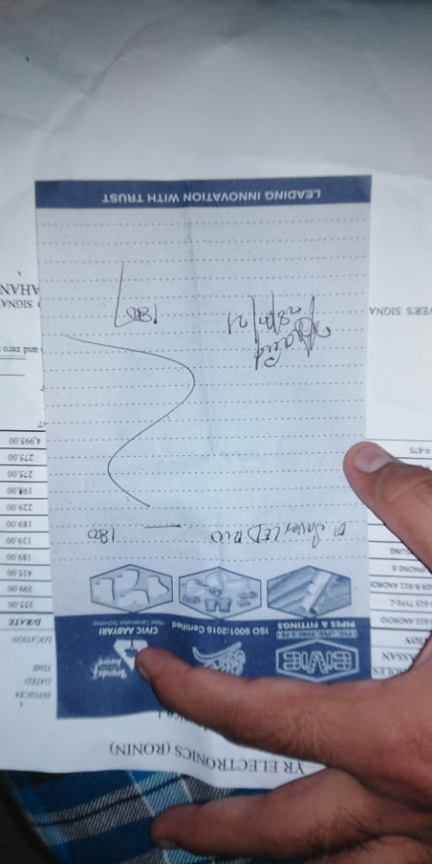
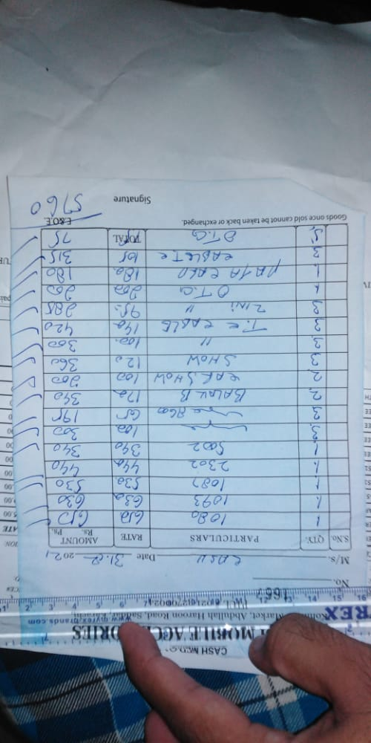
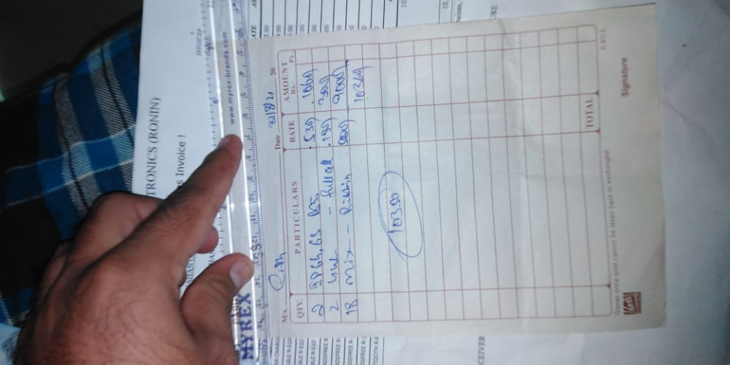

Slide 16
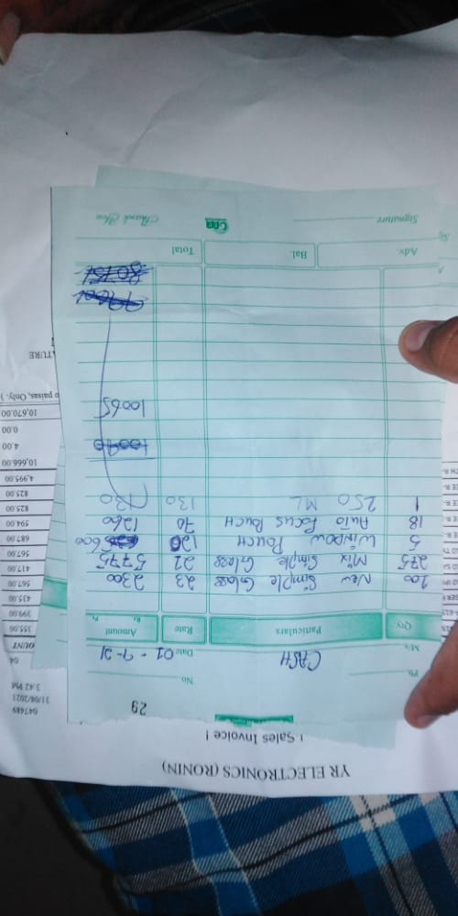
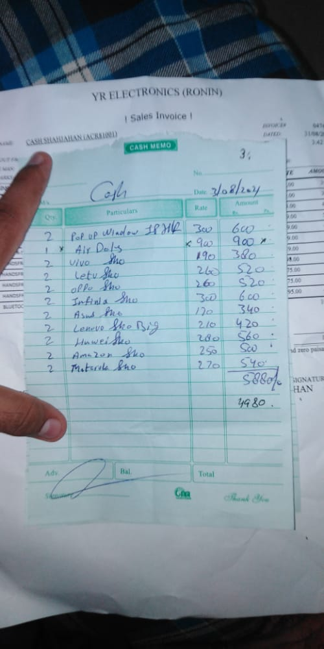
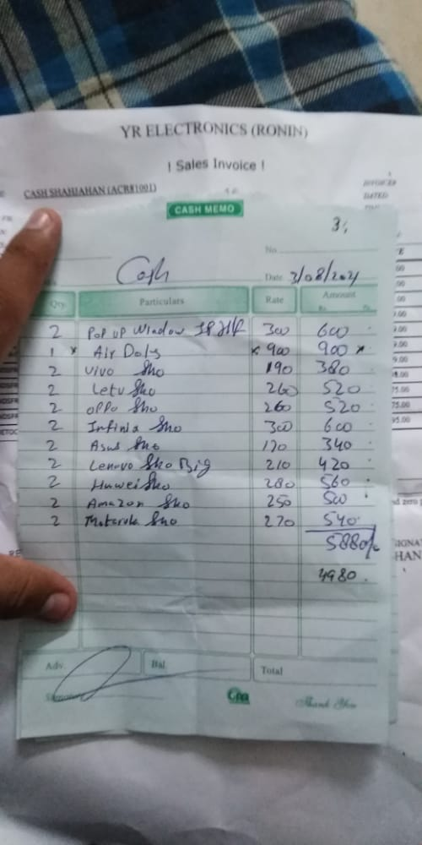

Slide 17
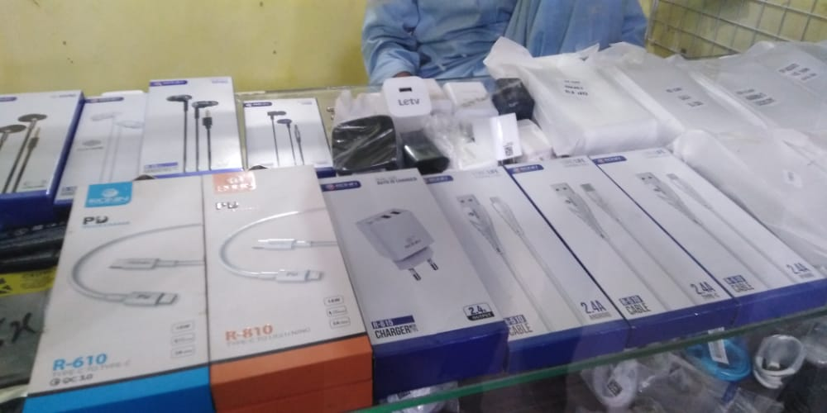
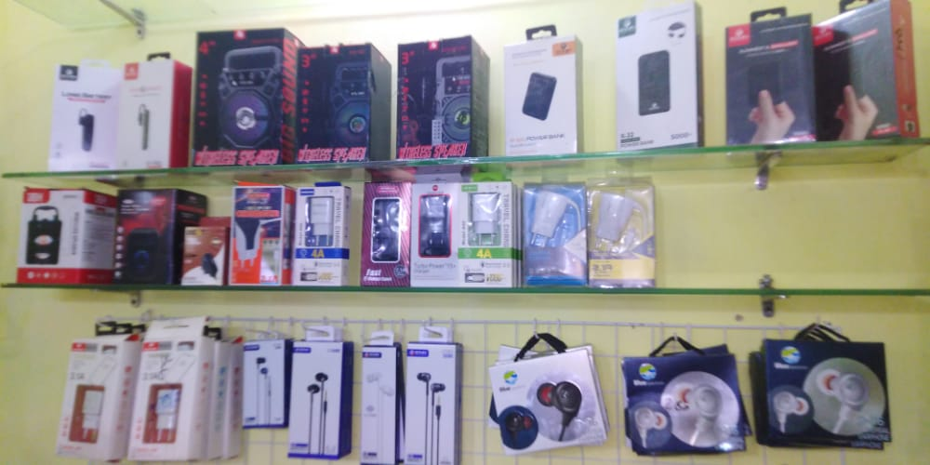
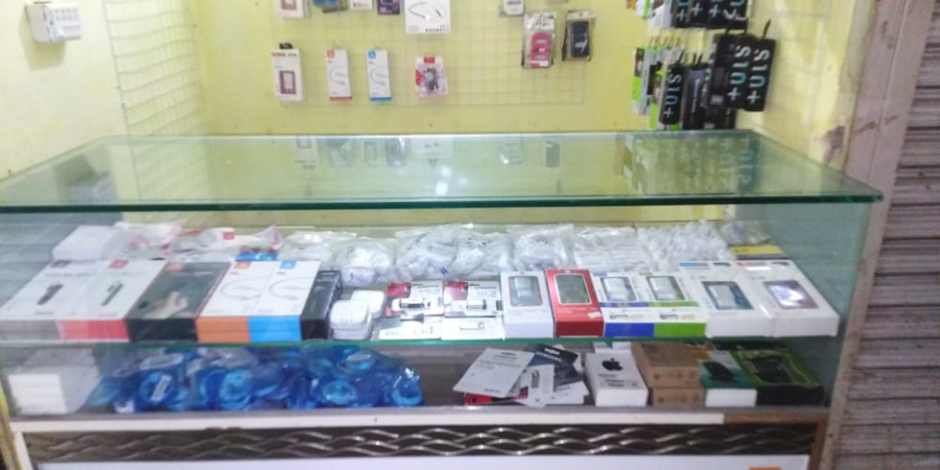
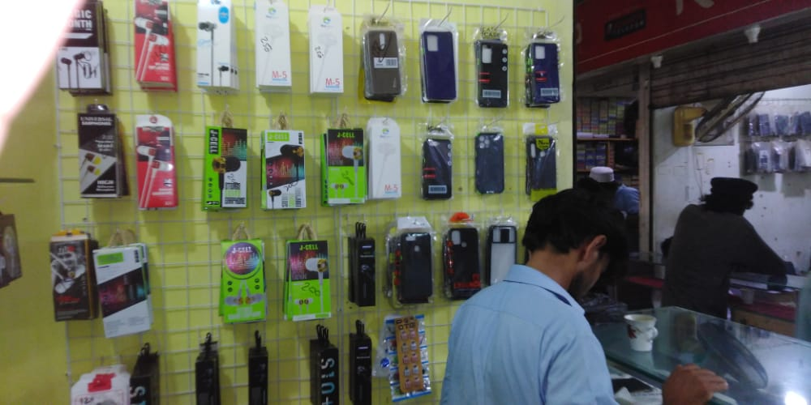
PICTURES OF MOBILE ACCESORRIES

Slide 18
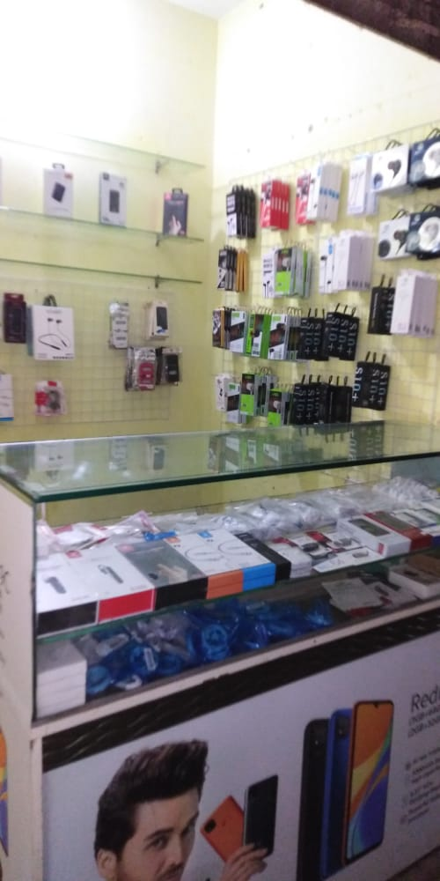
FINAL LOOK OF THE SHOP

Slide 19
